Slide 1


Hotel Recommendation System using ML
Discover how Machine Learning can revolutionize the way we choose hotels with our Hotel Recommendation System.
by
Mani Deep Murala
218T1A4235

Slide 2
Project Statement
1
The problem
2
The solution
Finding the perfect hotel that matches your preferences can be a daunting task.
Our Hotel Recommendation System uses Machine Learning to recommend suitable hotels based on user ratings and preferences.

Slide 3
Overview about Hotel Recommendation System
Personalized Recommendations
Efficient Choices
The system tailors hotel recommendations to individual preferences and past choices, providing a personalized experience for users.
Users can quickly find a hotel that fits their specific needs and style among a vast array of options, saving them time and hassle.

Slide 4

What is Machine Learning?
Definition
Machine Learning is a subset of AI that allows systems to automatically analyze data, learn from it, and improve performance over time without human intervention.
Machine Learning is the backbone of our recommendation system. It enables systems to learn from data patterns, enhancing their ability to make predictions or decisions without explicit programming. In the context of our project, Machine Learning empowers our system to understand user preferences and deliver tailored hotel recommendations.

Slide 5
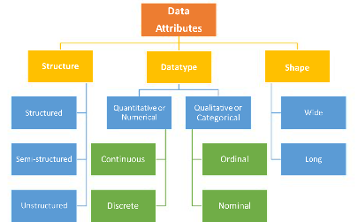
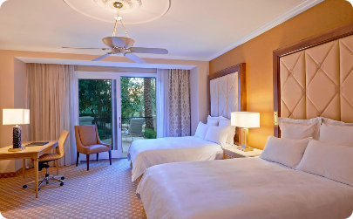
Dataset and Attributes
Attributes Used
Main attributes used for
Recommendation includes :
no of adults , no of children,
no of weekend nights , no of week nights , type of meal plan , required car parking space , room type reserved , lead time ,
arrival month , arrival date , market segment type , repeated guest , no of previous cancellations , no of previous bookings not canceled , avg price per room , no of special requests
Dataset Overview
Data Preparation
The dataset contains hotel information from different locations,star rating, and user reviews.
Data was pre-processed to deal with missing values, normalize features, and ensure that all attributes were in the right format.

Slide 6
Algorithms Used
Random Forest Algorithm
Used for classification and regression. Builds multiple decision trees and outputs the class that is the mode of the classes of individual trees.
The Random Forest Algorithm serves as the cornerstone of our recommendation system. This ensemble learning approach excels in handling diverse datasets and provides robust and accurate predictions. We'll explore why Random Forest is chosen over other algorithms and how it contributes to the success of our project.

Slide 7
Training and Testing
The dataset was split into a training set and a testing set.
Training set was used to build the model while the testing set was used to evaluate the model.
Iteratively refine the model based on testing results to optimize its accuracy and effectiveness in providing hotel recommendations.

Slide 8


End users of this Project
1
Travellers
2
Hotels
They can receive personalized recommendations for hotels that best suit their preferences and save time finding the perfect accommodation.
They can use this system to optimize their marketing strategies and to provide personalized experiences to their guests.
3
Travel Agencies and Booking Platforms
Travel agencies and booking platforms can seamlessly integrate the Hotel Recommendation System into their existing platforms. This integration would enable users to receive personalized hotel suggestions during the booking process, enhancing the overall user experience and increasing the likelihood of successful bookings.

Slide 9
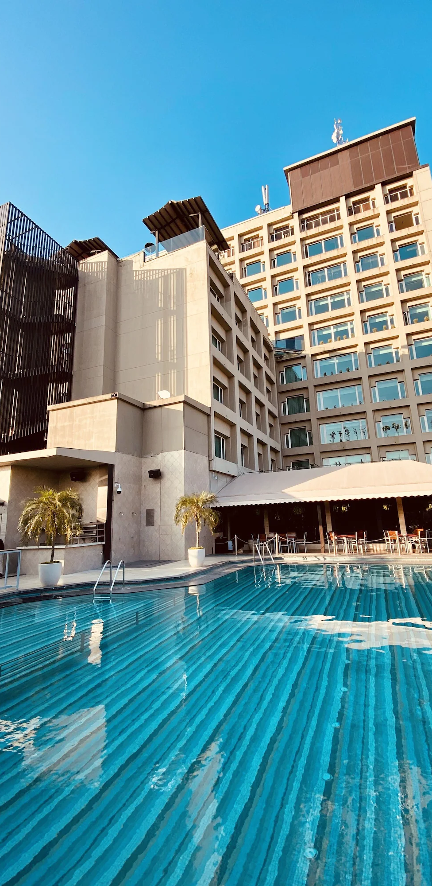
Advantages
Improved User Satisfaction
Time and Effort Saving
Providing personalized recommendations that match user preferences results in greater customer satisfaction and loyalty.
The system enables users to find hotels that match their preferences more efficiently, saving time and minimizing the stress of travel planning.
Discovery of new options
The system can be used by users that help them to explore new and discover more new options.

Slide 10
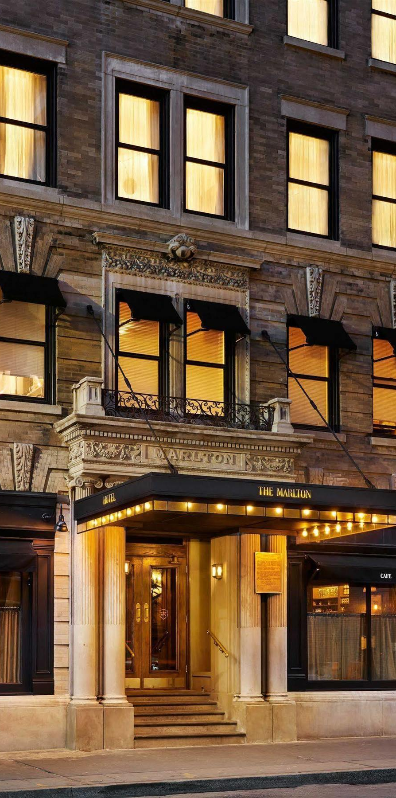
Challenges and Limitations
Challenges and Limitations
Privacy and Trust Concerns
Limited Contextual
Understanding
Implementing robust privacy measures may restrict the depth of user personalization, balancing privacy and system effectiveness.
Understanding nuanced contextual factors (e.g., special occasions, unique preferences) may be challenging
Unforeseen External Factors
External factors, such as unforeseen events or global crises, may impact the relevance of recommendations.

Slide 11
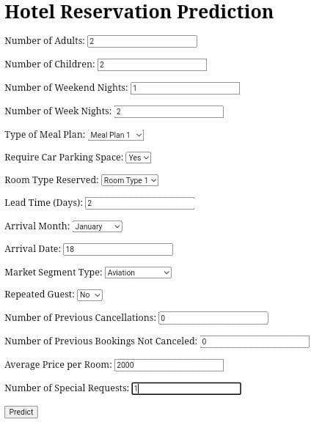
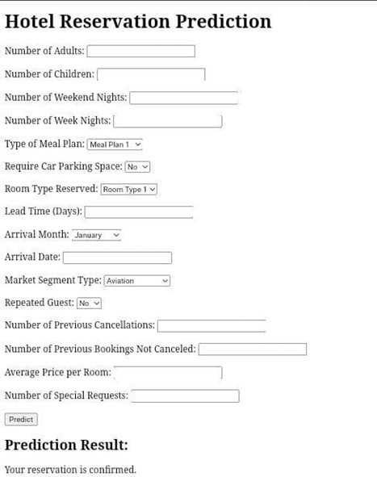
Screen Shots

Slide 12

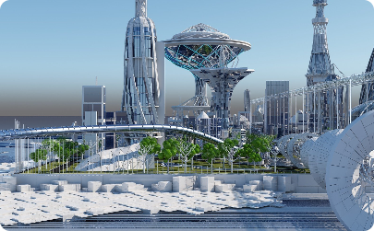
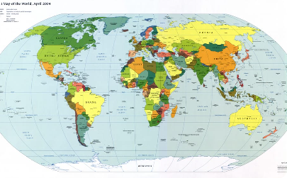
Conclusion
System Performance
Future of ML in Hotel Industry
Global Impact
The precision rate of the Hotel Recommendation System is high, resulting in more accurate hotel recommendations for users.
The Hotel Recommendation System using ML has the potential to revolutionize the hotel industry, making travel more personalized and efficient for people all over the world.
Use of Machine Learning in the hotel industry is expected to grow, with applications in areas such as carbon footprint management, price optimization, and more.

